Slide 1
The Commandery of the Bailiwick of Guernsey of The Most Venerable Order of the Hospital of St John of Jerusalem
European Regional Meeting
Monday January 28th, 2019

Slide 2
Corporate Structure
Commandery
Emergency Ambulance Service
Voluntary Services
Commercial Services
Property Holding Company
“Not for profit”; contracted to States of Guernsey
Charitable activities

Slide 3
Activities
Guernsey's only “Blue light” emergency ambulance service - average 14 call outs per day, c.40 employees - £3.5m annual cost; 70% funded by States of Guernsey
Volunteer activities - front line support to EAS (Community First Responders, Ambulance reserve) - first aid / ambulance services at public events - maritime ambulance (“Flying Christine”) - youth activities (Badgers and cadets) - “community services” (combatting social isolation/social prescribing) - library, patient transport
Commercial activities - higher quality revenue than donations / bequests - retail outlet selling consumables and quality of life “enhancers” - Stannah stair lifts - training

Slide 4
Community First Responders

Slide 5
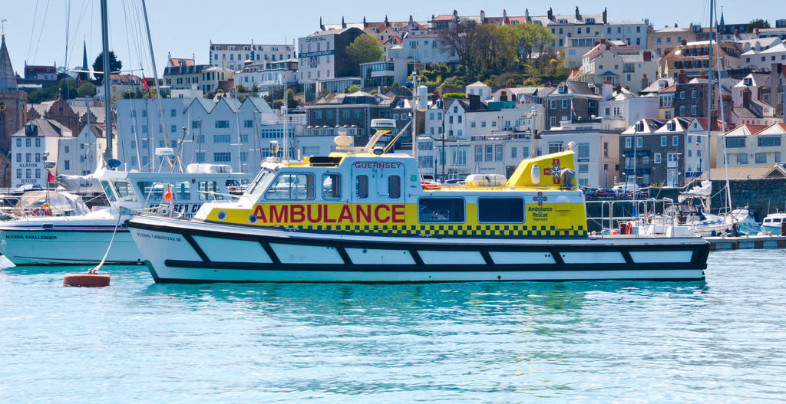
Flying Christine III

Slide 6
Recent Achievements
Stabilisation of a defined benefit pension scheme with a £5m deficit
Renewal of the emergency ambulance contract with the States of Guernsey for the next ten years
Turn around of the commercial division – break even to £150k profit in 2018
Reorganisation, enhancement and modernisation of voluntary activities following establishment of a small professional executive management team
Re-establishing connections with Jersey in order to identify and share best practice
Refocus on community and first aid activities (cessation of cliff and inshore rescue services)
Collaboration with other organisations for the benefit of our community

Slide 7
Challenges and goals
Resetting relationship between EAS and volunteer teams
Rejuvenating fund raising activities
Developing St John’s status as the leading third sector provider of health care related services in Guernsey
Re-integrating with wider St John (youth / competitions, leveraging Priory resources and experience)
Updating constitutional documents
Succession planning, and the “next generation”

Slide 8
Questions?

Slide 9
European Regional Meeting
28th – 29th of January

