Slide 1
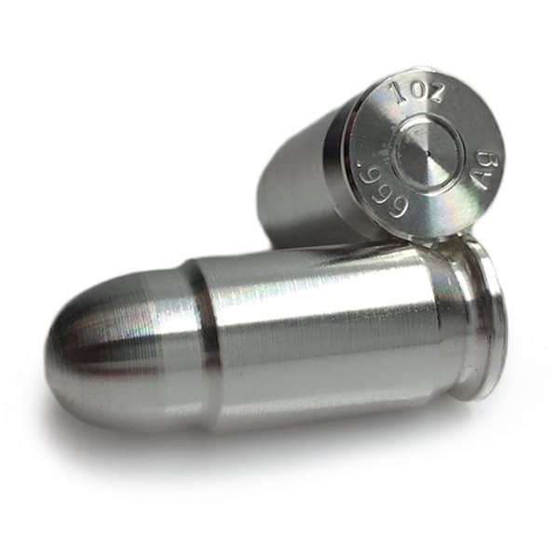
In search of the silver bullet….
Effective communications at St John
Notes:
What I’m going to cover
Effective communications
Our new approach and why we’re taking it
Discussion about what you need
A simple checklist
Can quickly become about channels – the next communications answer or gimmick. Clarity of purpose, strength of audience planning and consistency of execution. None of which needs to be overly complex or involved (although you can spend a fortune!)
Start with what we’re seeking to do and why
Audiences – many different breakdowns but to keep to a high level. How do we want to be perceived by
The public
Stakeholders/customers
St John People
Young people as a specific audience – language, channel, relevancy etc. But many audiences within young people (Channel 4 tribes work)
Clarity of purpose (mentioned a lot yesterday)
We also touched on the topic of induction (discussed yesterday) – how do we help our people to understand our purpose; how do we support them to share and express our values and principles?

Slide 2
Why do we communicate?
Notes:
Having a clear understanding of why you are communicating will have an impact on how successful any communication is
Who is the audience and how do we want them to respond
What should they know about us (and do they already?)
What should they think about us (and how different is that to now?)
How should they feel about us (and do they feel that already?)
And what do we want them to do – volunteer, support, advocate, champion, give…….

Slide 3
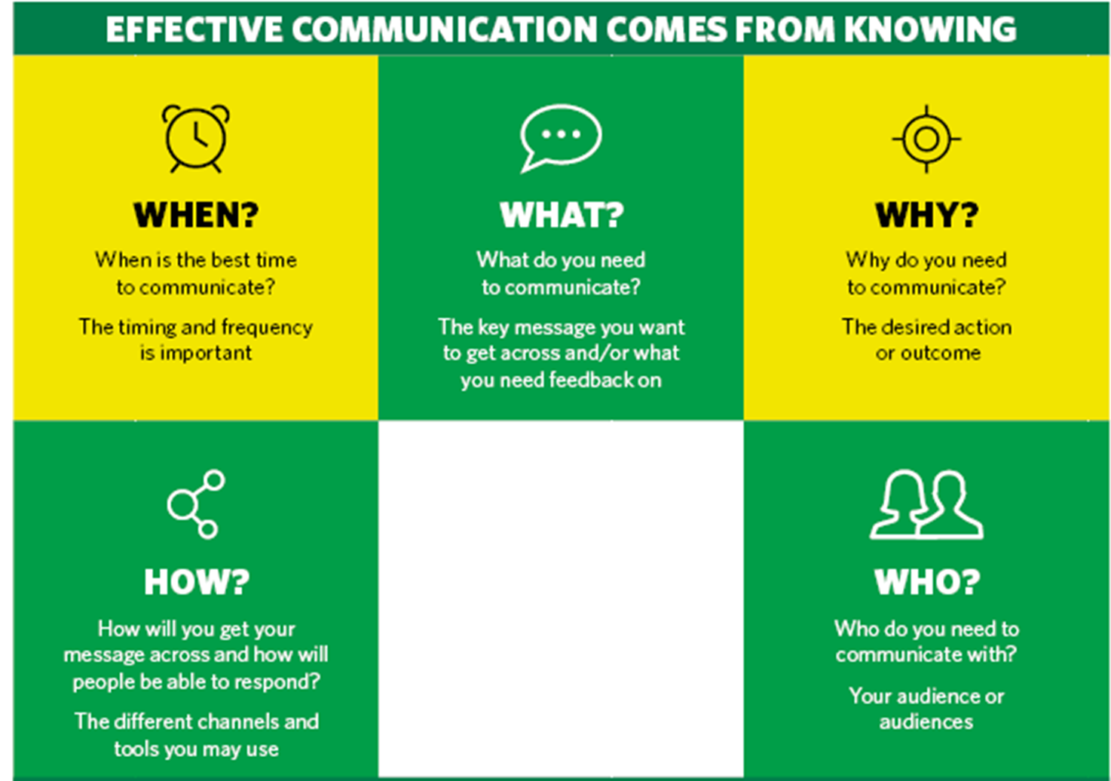
Notes:
From the all important why, comes the who and the what and only from there comes the when and the how – the channels, the timing, the tools, the language…..

Slide 4
Our rationale for change
St John Ambulance is well known and loved but not known well. Our impact in many communities across the country is hidden in plain sight. We can do more to support our people to be our greatest ambassadors
?
Notes:
Relevance and identity as route to tangible public support – PURPOSE AND AUDIENCE

Slide 5
Our rationale for change
St John Ambulance is well known but not known well. Our impact in many communities across the country is hidden in plain sight. We can do more to support our people to be our greatest ambassadors
Communications is regularly raised by volunteers and employees as needing attention. We need to elevate the relevance and focus of communications so that they better connect with the rest of the charity and serve its refreshed purpose
We need to develop measurement and evaluation to build a compelling story of our impact. Resourcing this critical task properly requires a firm commitment, dedicated expertise and time.

Slide 6
A changed approach
FROM… |  | TO…
A focus on what we can do… |  | …. a focus on what others can do. Continuing to value professional expertise, whilst enabling others through leadership and best practice.
Narrow volunteer engagement… |  | … increased and more direct volunteer engagement, and increased focus on inside to out communications
Siloed planning and resourcing despite efforts to collaborate… |  | … collective strategic planning within an interdependent structure
A brand permission culture with our “brand” seen as restrictive… |  | …. a brand empowerment culture, shifting focus from “brand” to a focus on purpose and mission; from “big bang” campaigns to a steady drumbeat of public awareness, engagement and support
Loose goals and limited performance reporting… |  | … specific, measurable, strategic objectives and regular, visible performance reporting
Inconsistent and risk averse communications… |  | …. integrated 360 communications that are bold and creative
Series of disconnected change projects and communications... |  | ... integrated programme of change and communications with consideration of the cumulative effect

Slide 7
Group activity
Why is effective communication important for you?
What do you want to achieve from your communications?
What are some of the challenges and barriers that affect your communications?

Slide 8
Key to getting it right…
Notes:
Language, tone etc….

