Slide 1
Α. CYPRUS AT A GLANCE

Slide 2
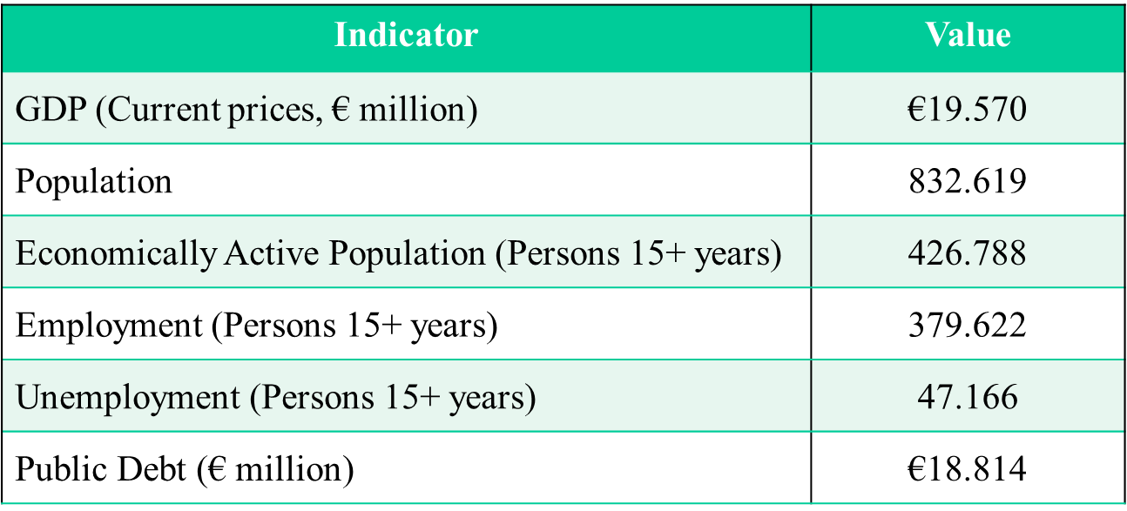
Main Economic Indicators for Cyprus (2017) (Source: Statistical Service of Cyprus)

Slide 3
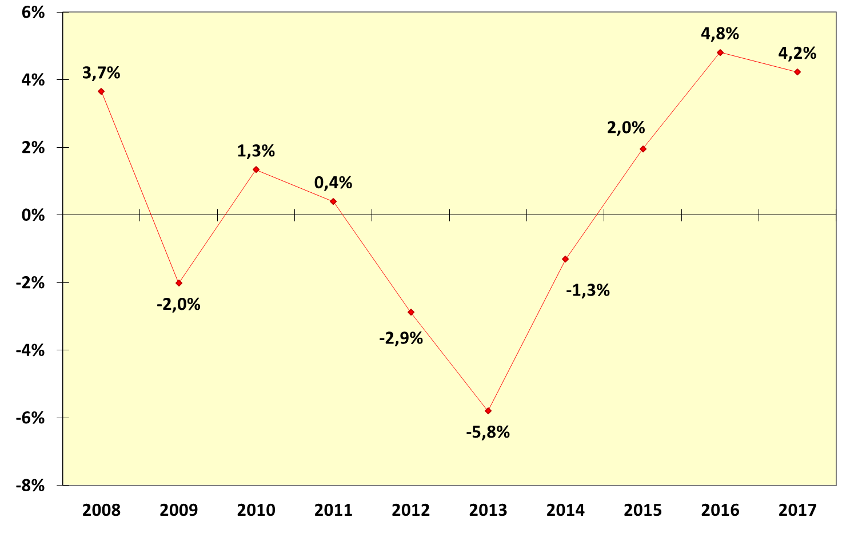
GDP percentage change during the period 2008-2017 (Constant prices 2010) (Source: Statistical Service of Cyprus)

Slide 4
Employment percentage change in Cyprus during the period 2008-2017 (Source: Labour Force Survey)

Slide 5
Employment rate in Cyprus during the period 2008-2017 (Source: Labour Force Survey)

Slide 6
Unemployment percentage change in Cyprus during the period 2008-2017 (Source: Labour Force Survey)

Slide 7
Unemployment rate in Cyprus during the period 2008-2017 (Source: Labour Force Survey)

Slide 8
Public Debt (% of GDP) during the period 2008-2017 (Source: Statistical Service of Cyprus)

Slide 9
GDP by sector in 2017 (Source: Statistical Service of Cyprus)

Slide 10
B. ST JOHN IN BRIEF

Slide 11
Organizational Issues:
Dropped the dual system as from 1/9/2018
New Chairpersons in
Nicosia
Limassol
Paphos
New members appointed to Drst. C’ tees

Slide 12
Economic Indices:
Revenue: € 105.835,00
Expenditure: € 115.628=
But: €13,550 Depreciation on new Buildings
Problematic Areas:
No legal provisions covering all population
Too many providers as a result of
Subsidization by HRDA
Rather weak criteria as to who can be a provider
Acute competition
F.A. in secondary schools
Offices in Limassol

Slide 13
Instructors: Moving Sands
High Turnover
Never know where you stand
Problem to live with it
F.A Manual
Translation into Greek
Obliged to issue a Supplement
Voluntarism: Concerted efforts to develop it
Free courses in F.A. to interested persons
New nominations/appointment to key positions
Lectures all over Cyprus on F.A.
Emphasis on F.A. for babies & children
Contacts with 3 yrs. old trainees

